Slide 1



Assignment-1
Web Programming
Student: Shukirillaev Mukhammad Sodik Sherzodbek Ugli
Department:Computer Engineering

Slide 2
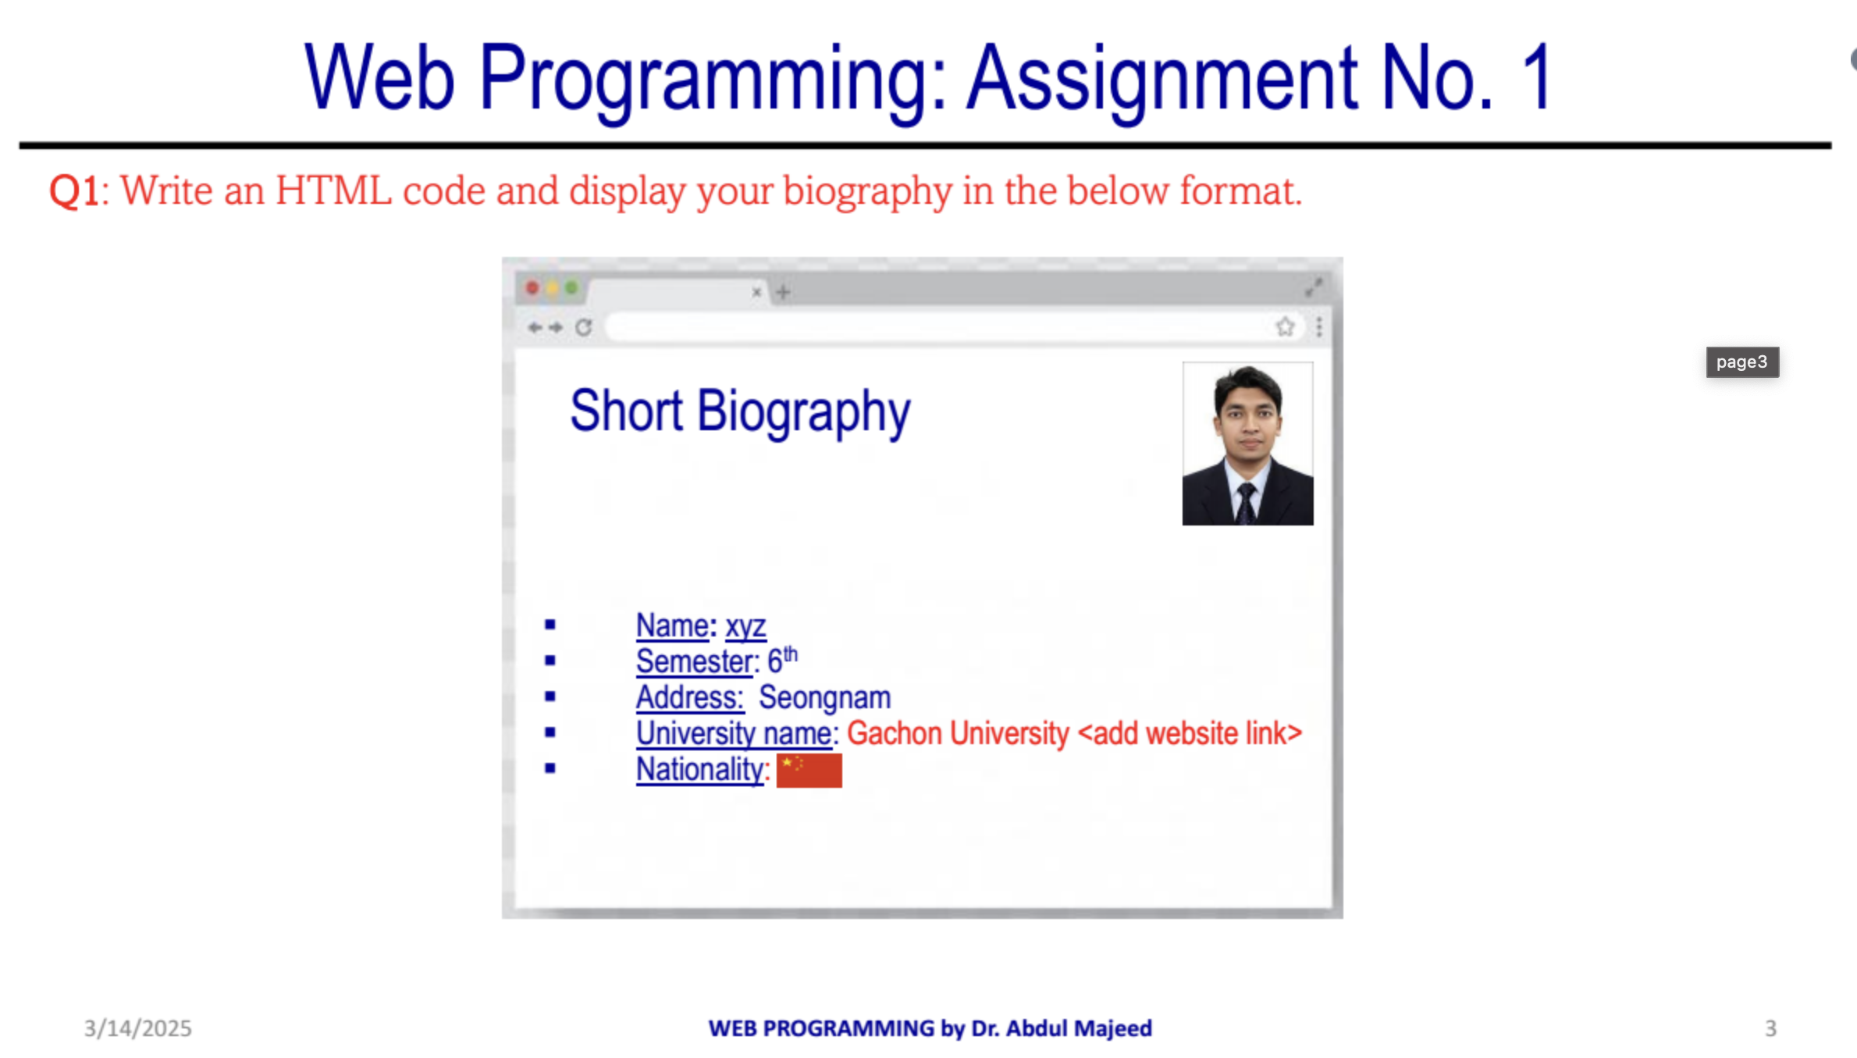
Question 1:

Slide 3
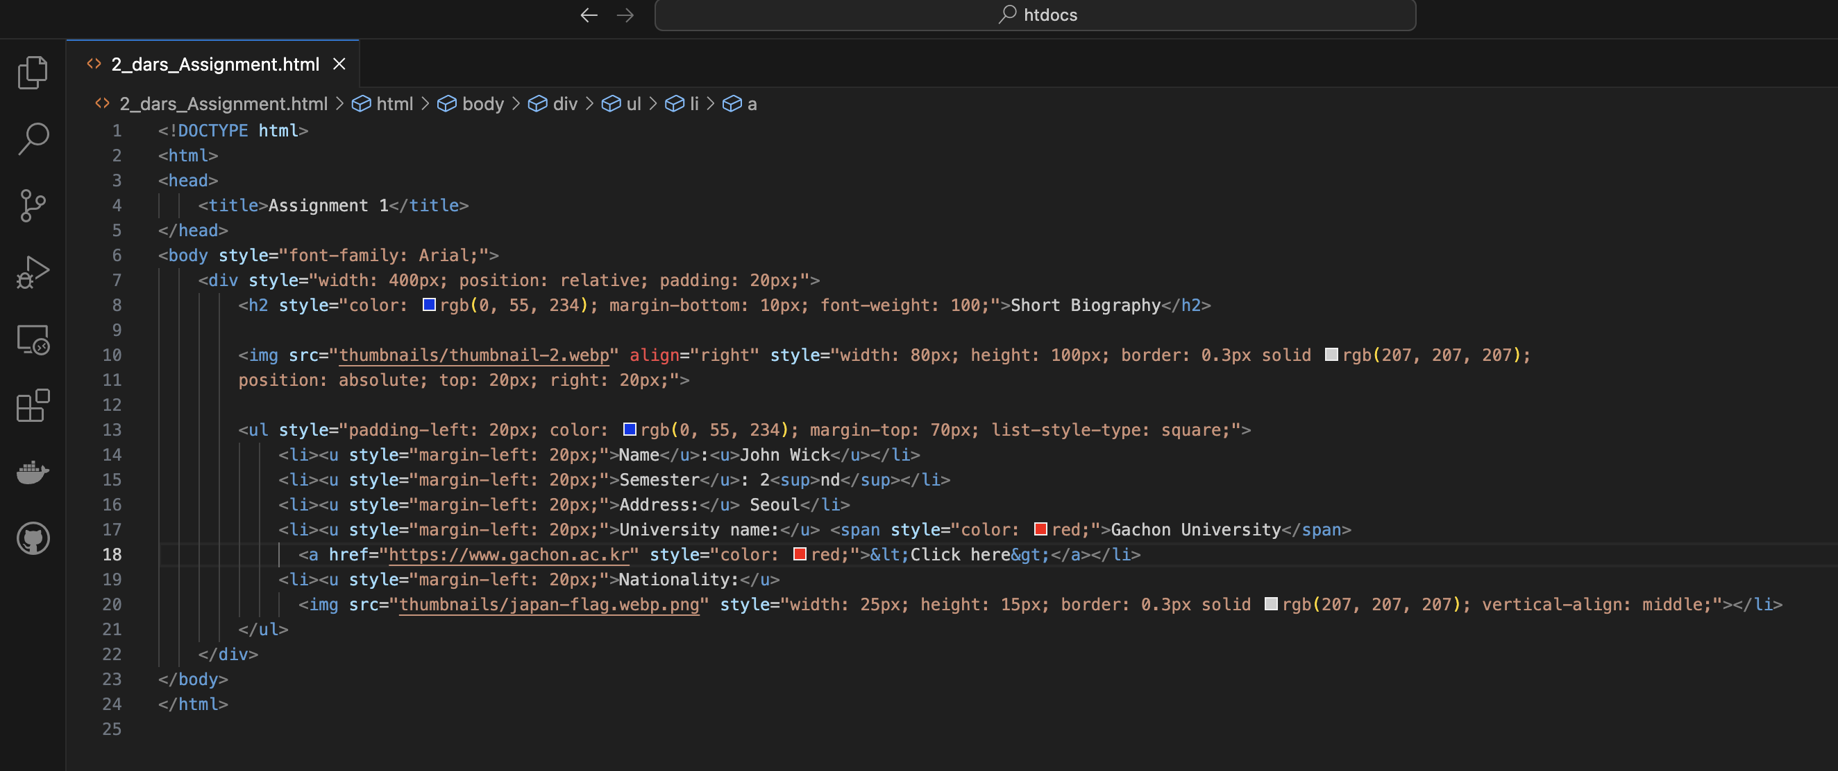
Code:

Slide 4
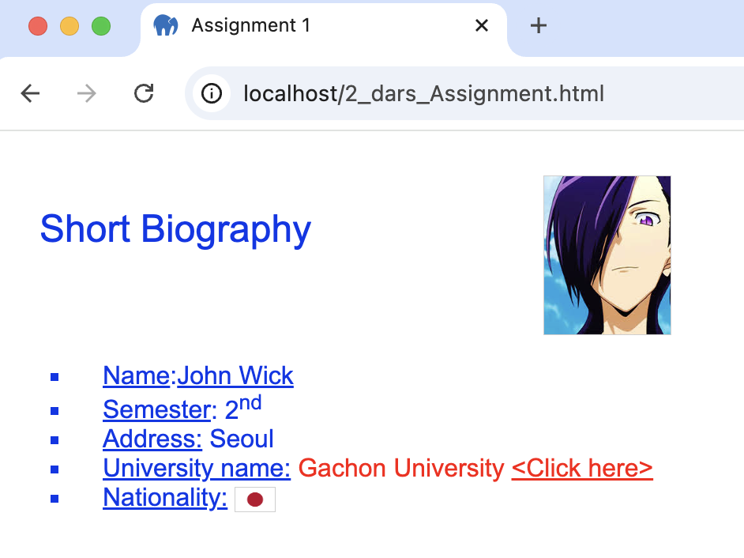
Result

Slide 5
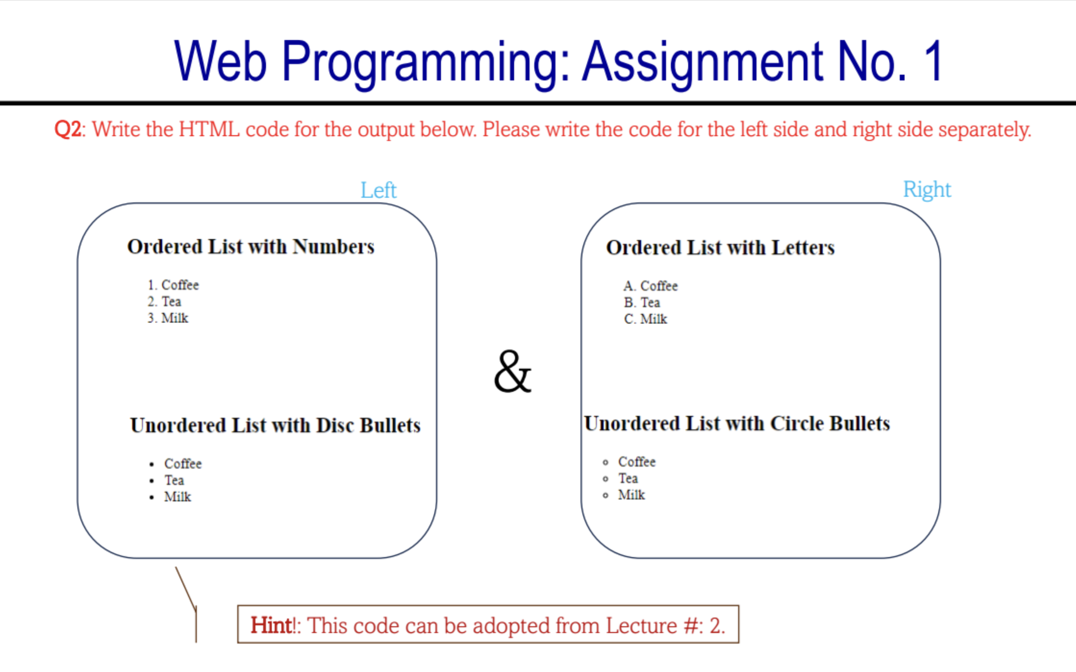
Question 2:

Slide 6
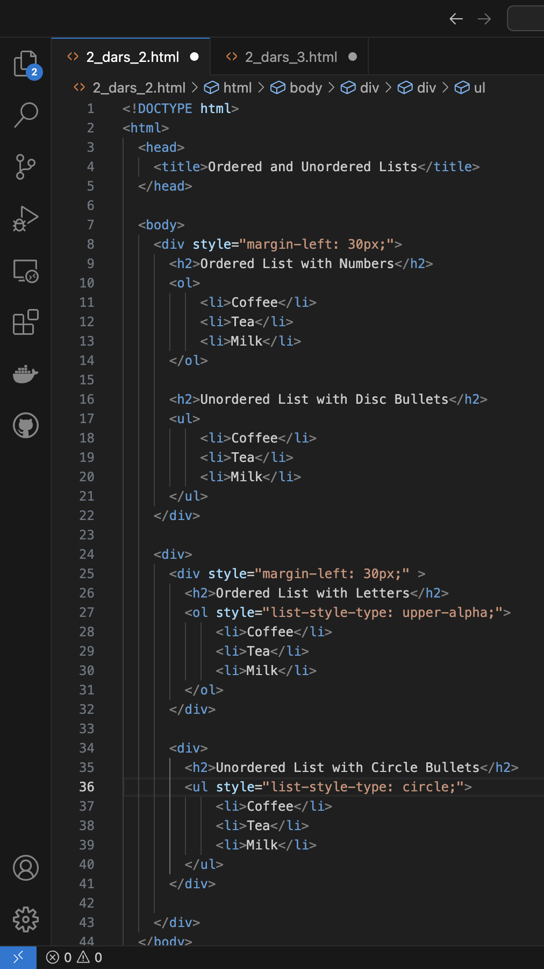
Code:

Slide 7
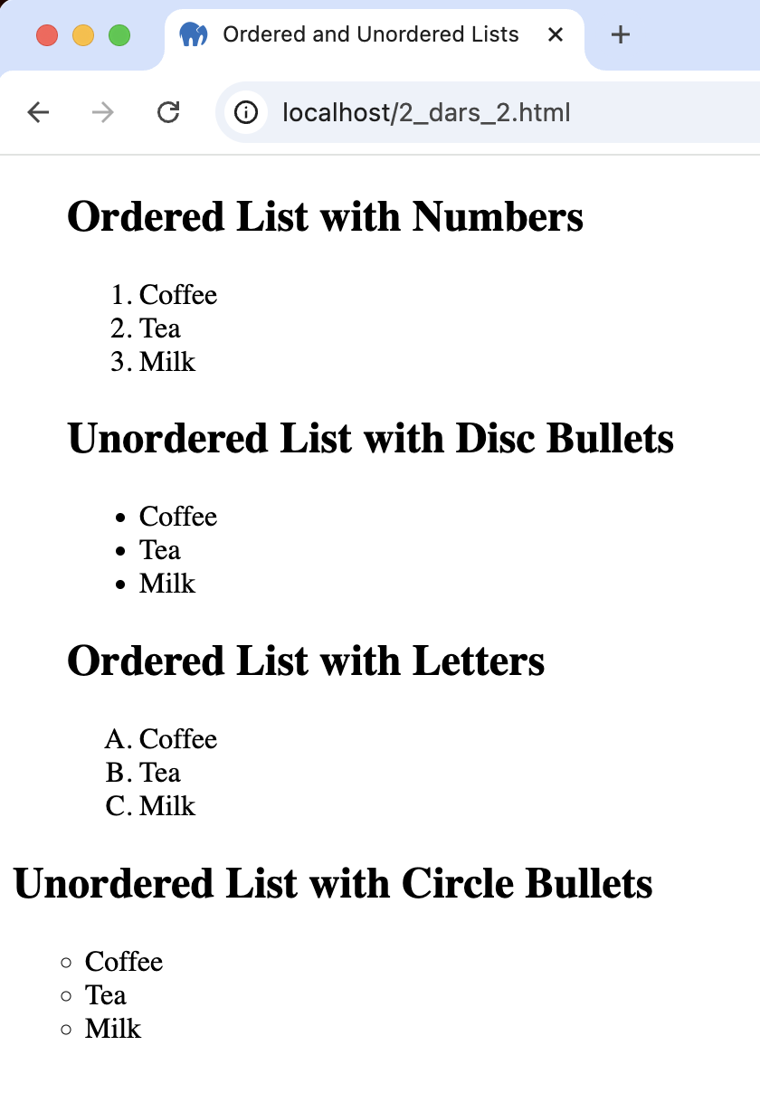
Result

Slide 8
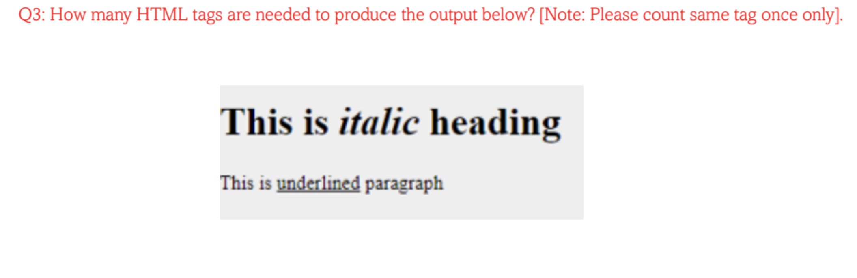
Question 3:

Slide 9
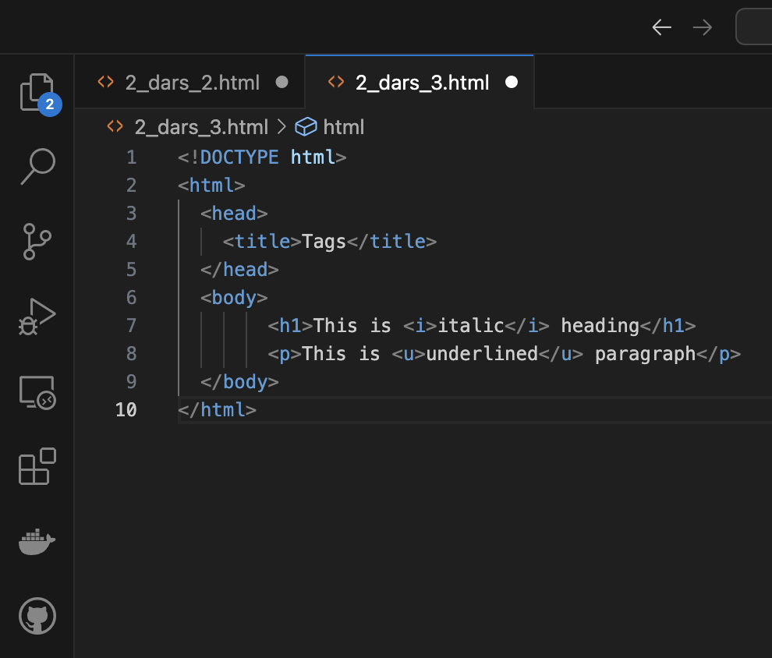
Code:

Slide 10
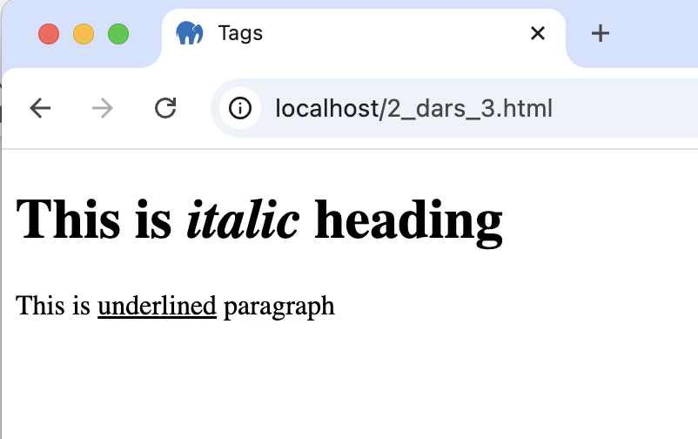
Result
d
It depends. The minimum amount is 4!

Slide 11
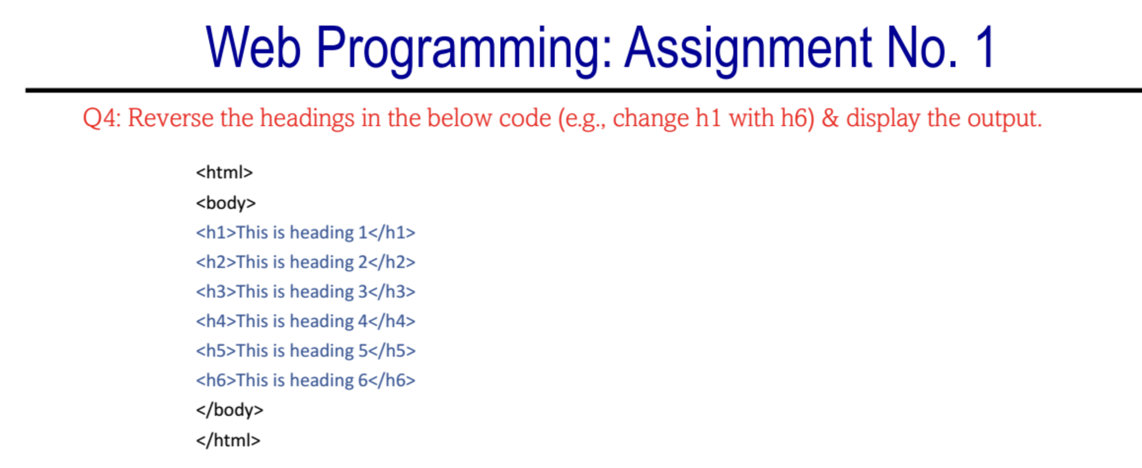
Question 4:

Slide 12
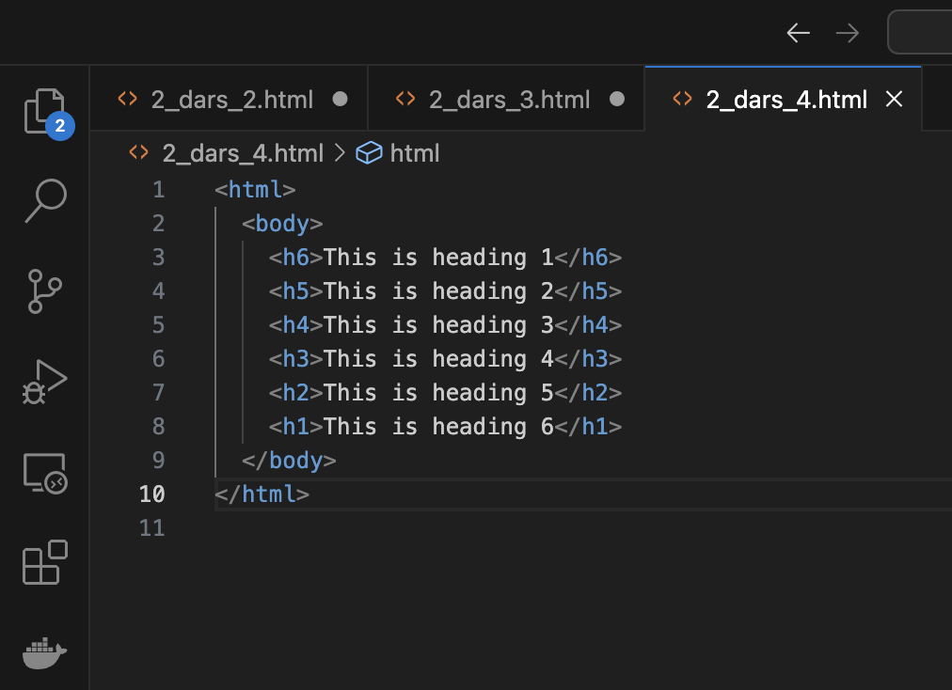
Code:

Slide 13
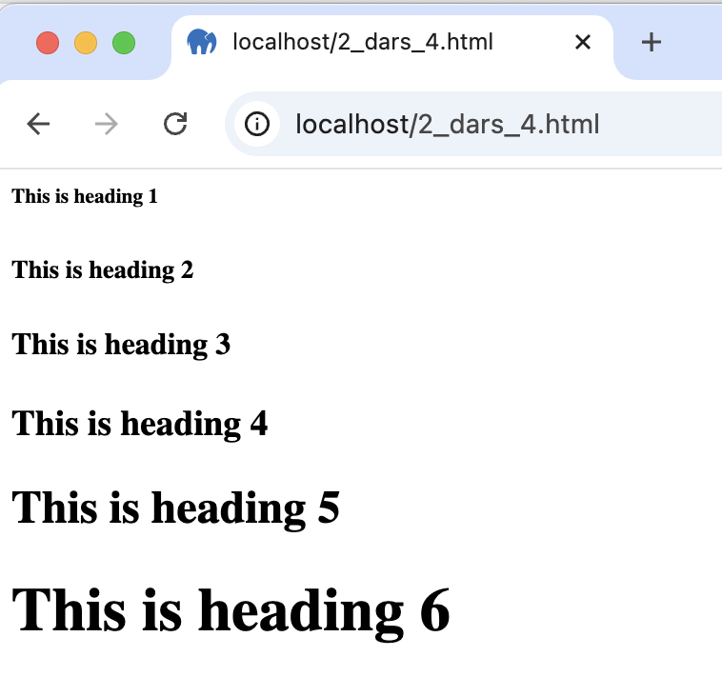
Result
d

Slide 14
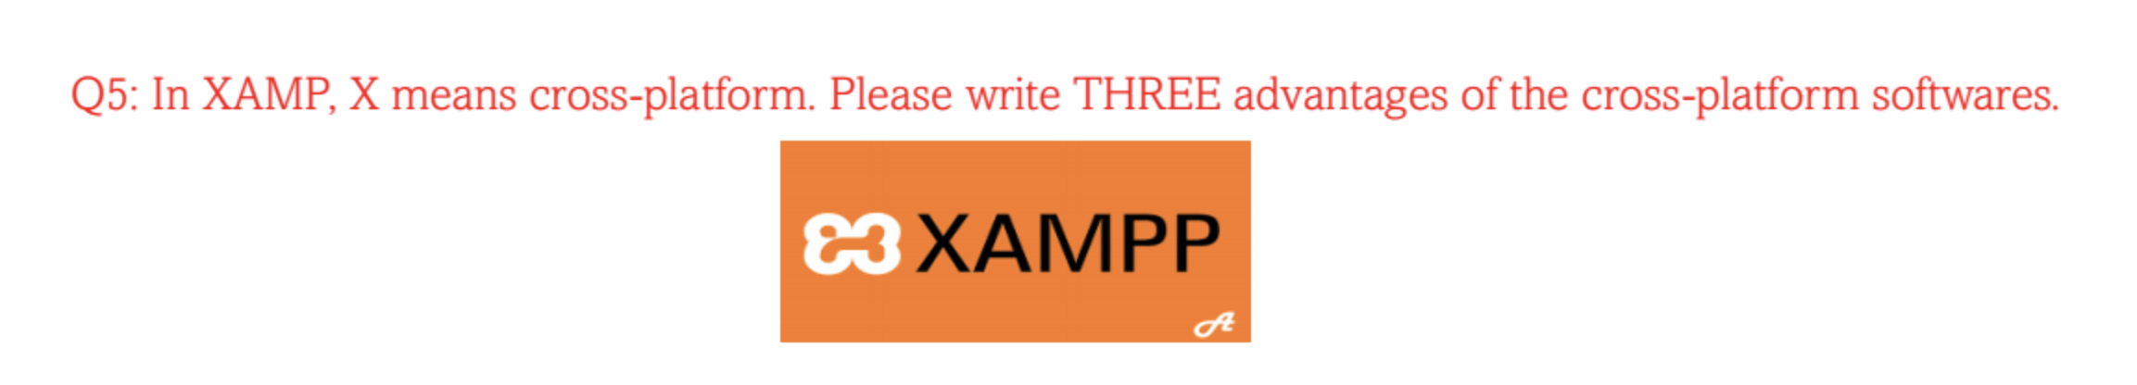
Question 5:
1. Saves Money: Instead of making separate versions for each platform like Windows, macOS, or mobile, developers can write the code once and use it everywhere. This reduses the time and money spent.
2. Reaches More People: Cross-platform software works on different devices and operating systems, meaning more people can use it, no matter what device they have.
3. Easier to Update: Since there’s only one version of the software, it’s much easier to fix problems or add new features. Developers can make changes once, and it automatically applies to all platforms.

